Slide 1



Hunger_in_US
View in Power BI
Last data refresh:
6/19/2020 3:07:13 AM Central Standard Time
Downloaded at:
6/19/2020 3:25:39 AM Central Standard Time

Slide 2


Slide 3


Slide 4
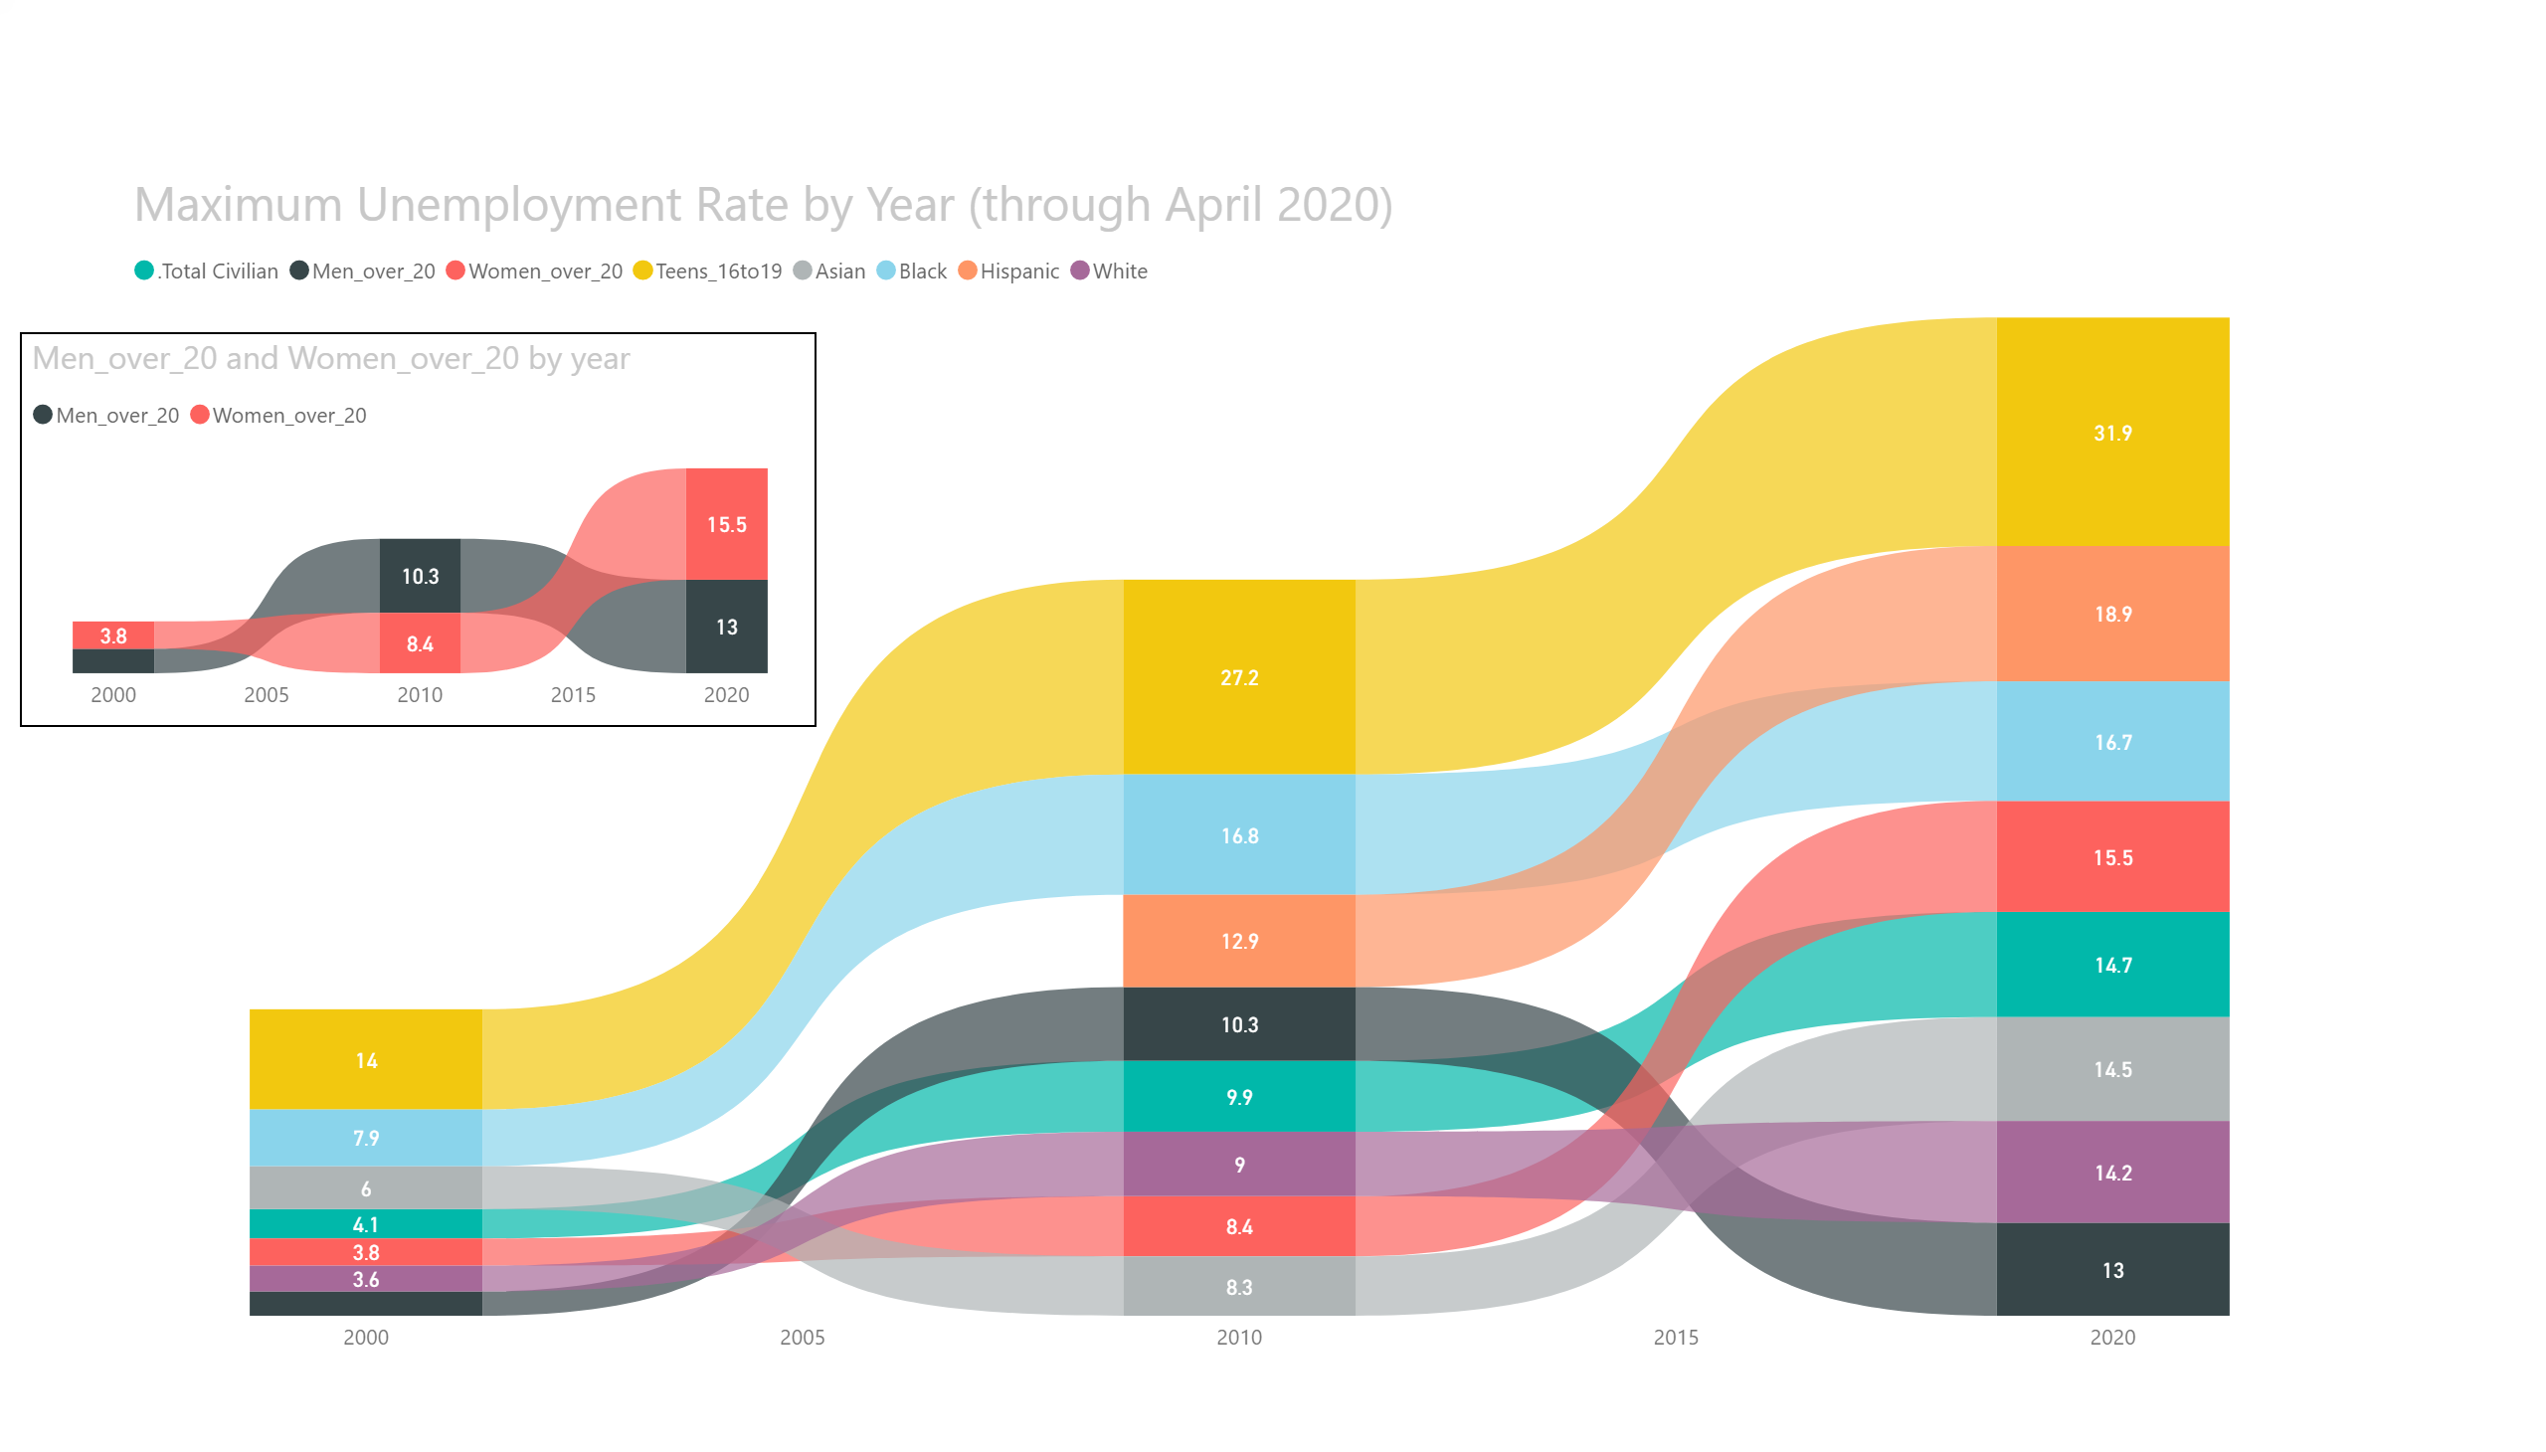

Slide 5
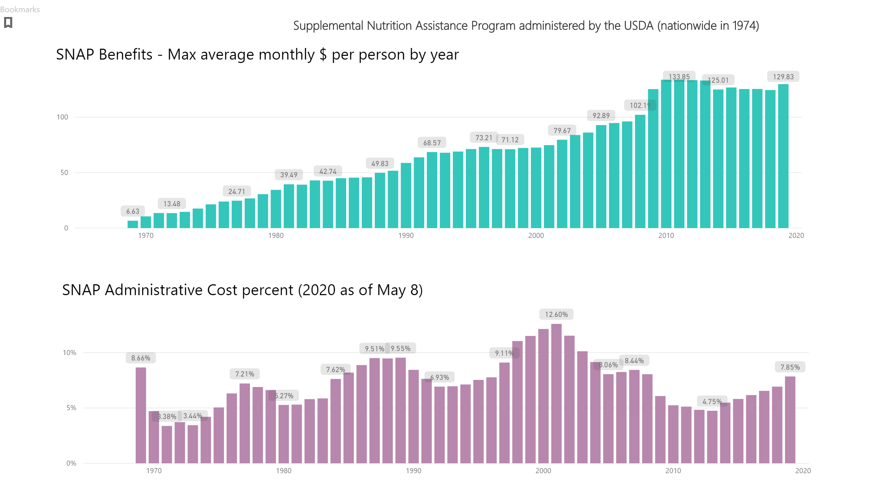

Slide 6
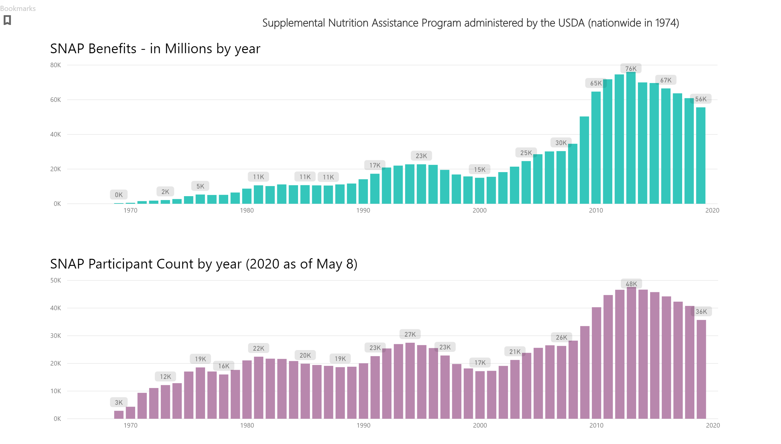

Slide 7
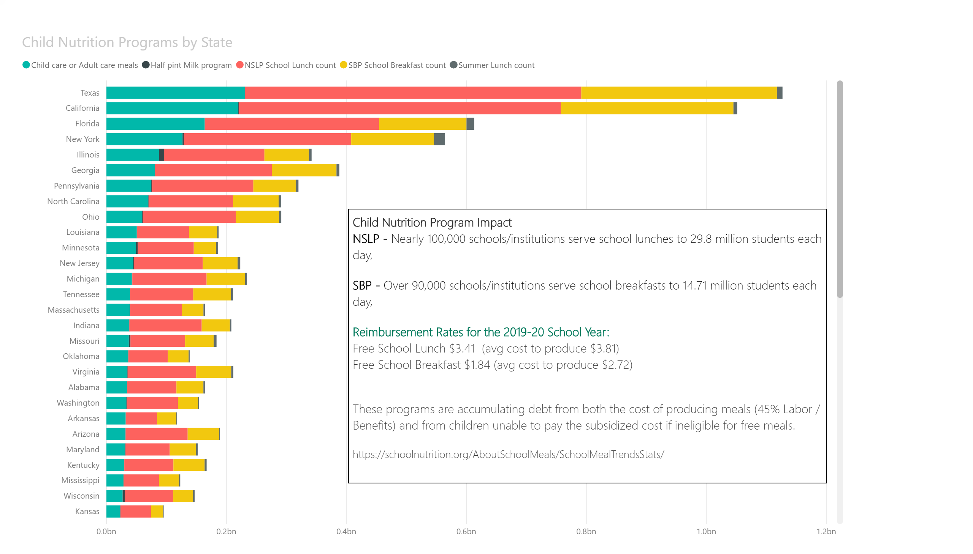

Slide 8
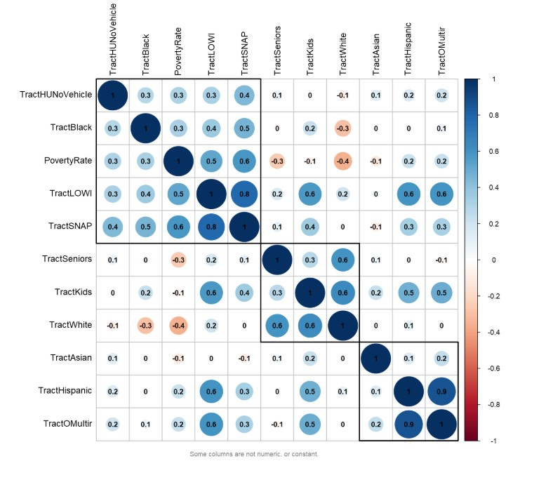
2010 Census tracts correlation by Demographics
Census tracts group for
SNAP benefits
Low Income
Poverty Rate
Household with No Vehicle
Black
Households reporting multi-race
correlate with Hispanic
Power BI has State filters

Slide 9
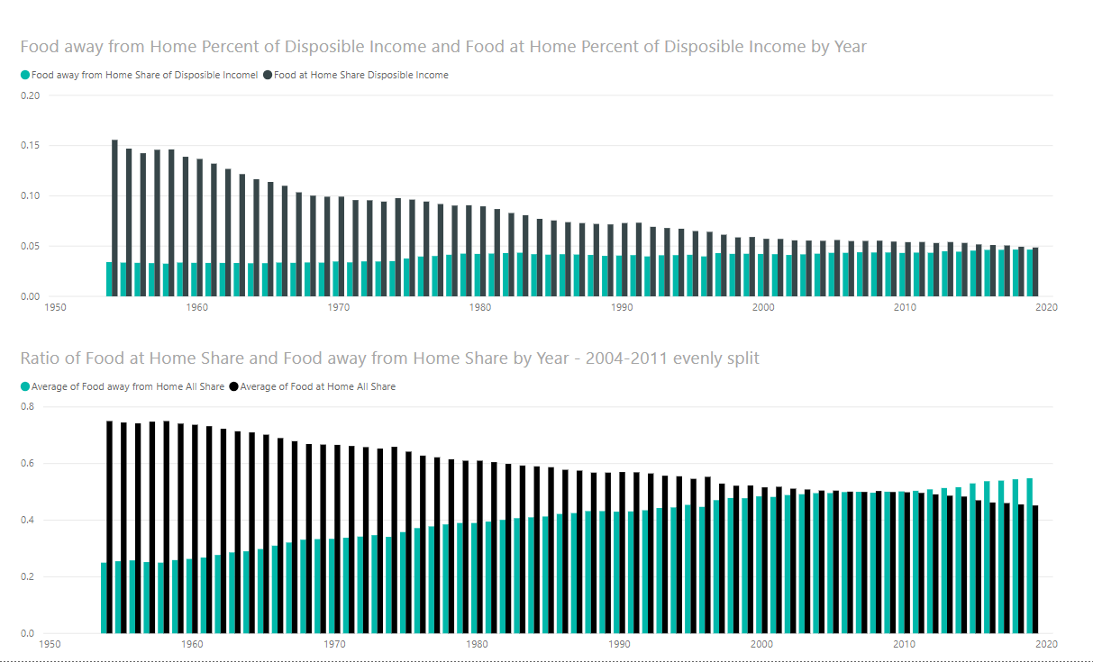

Slide 10
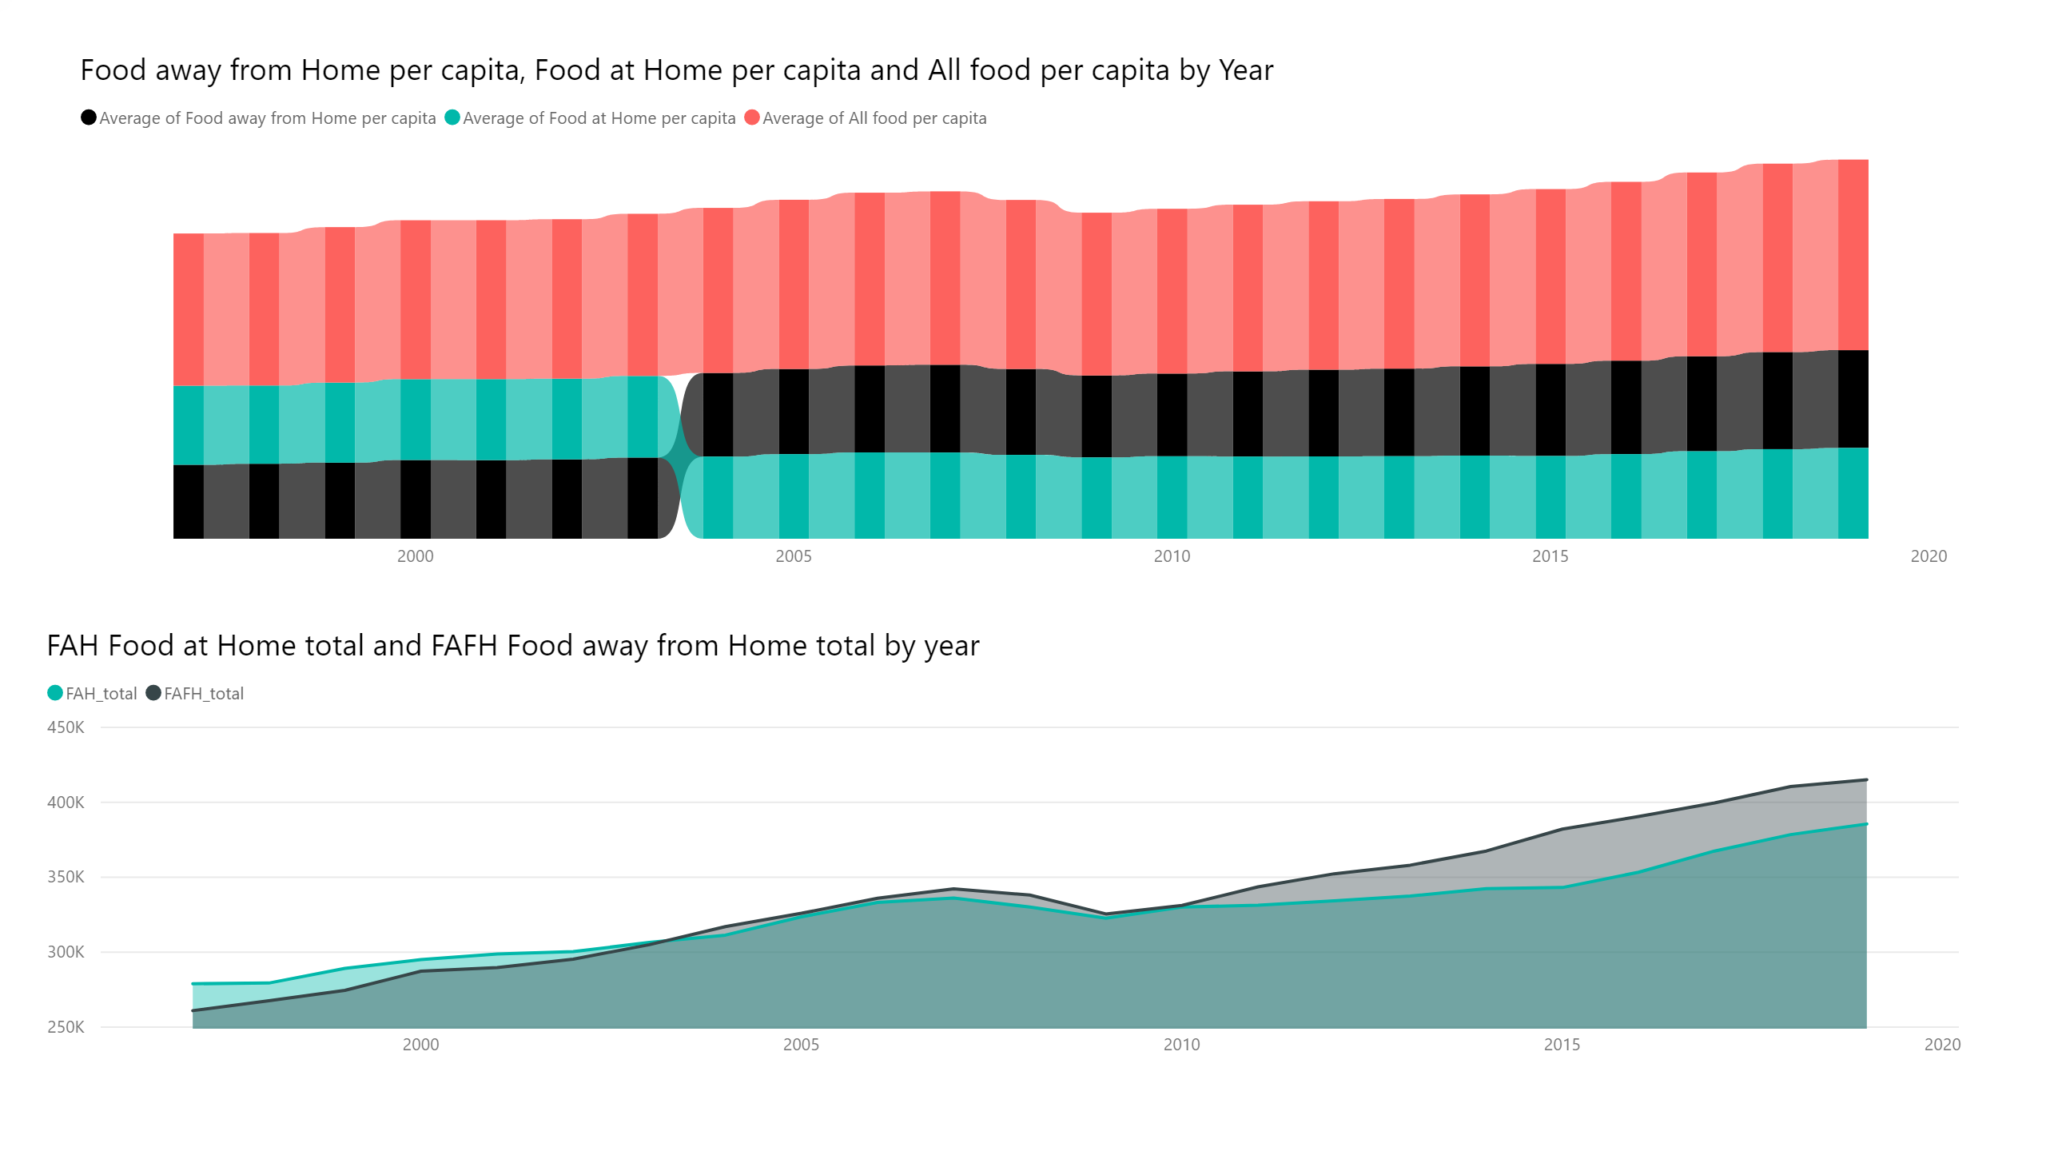

Slide 11
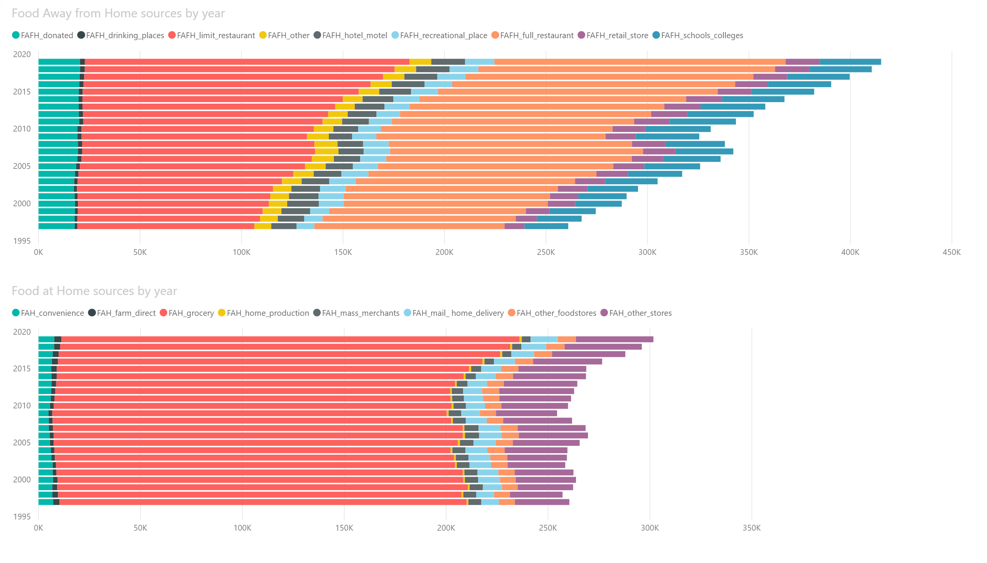

Slide 12
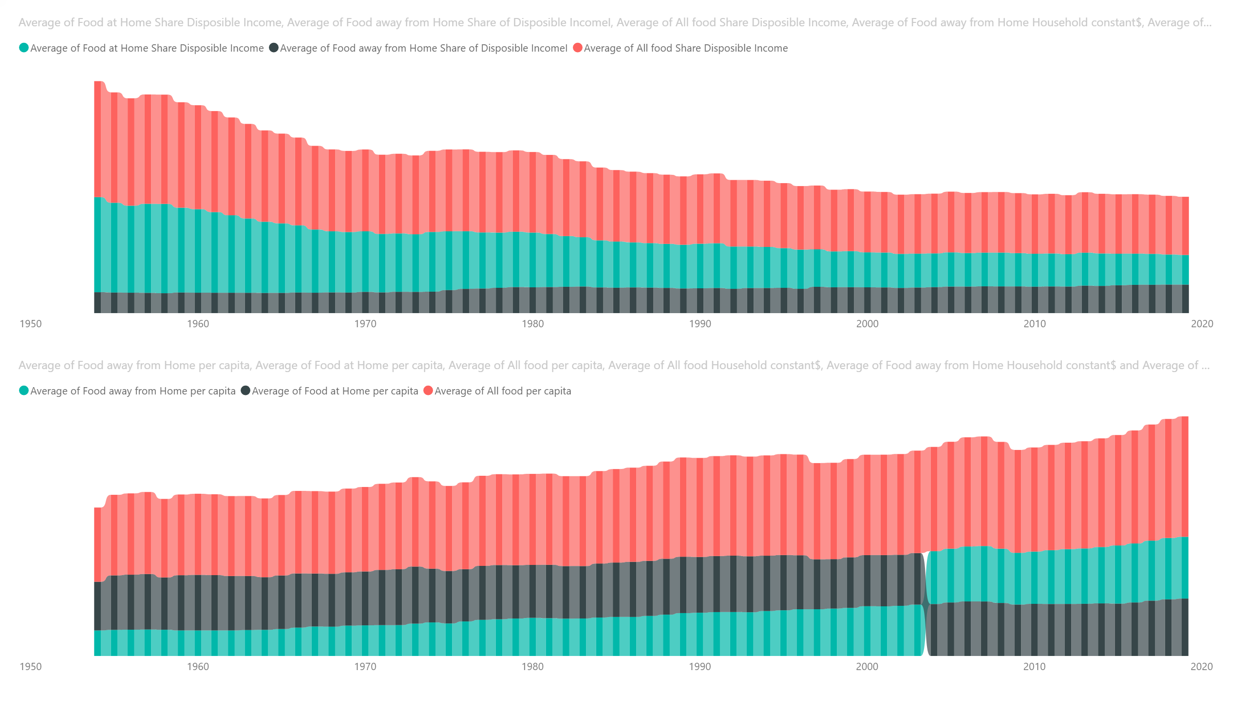

Slide 13
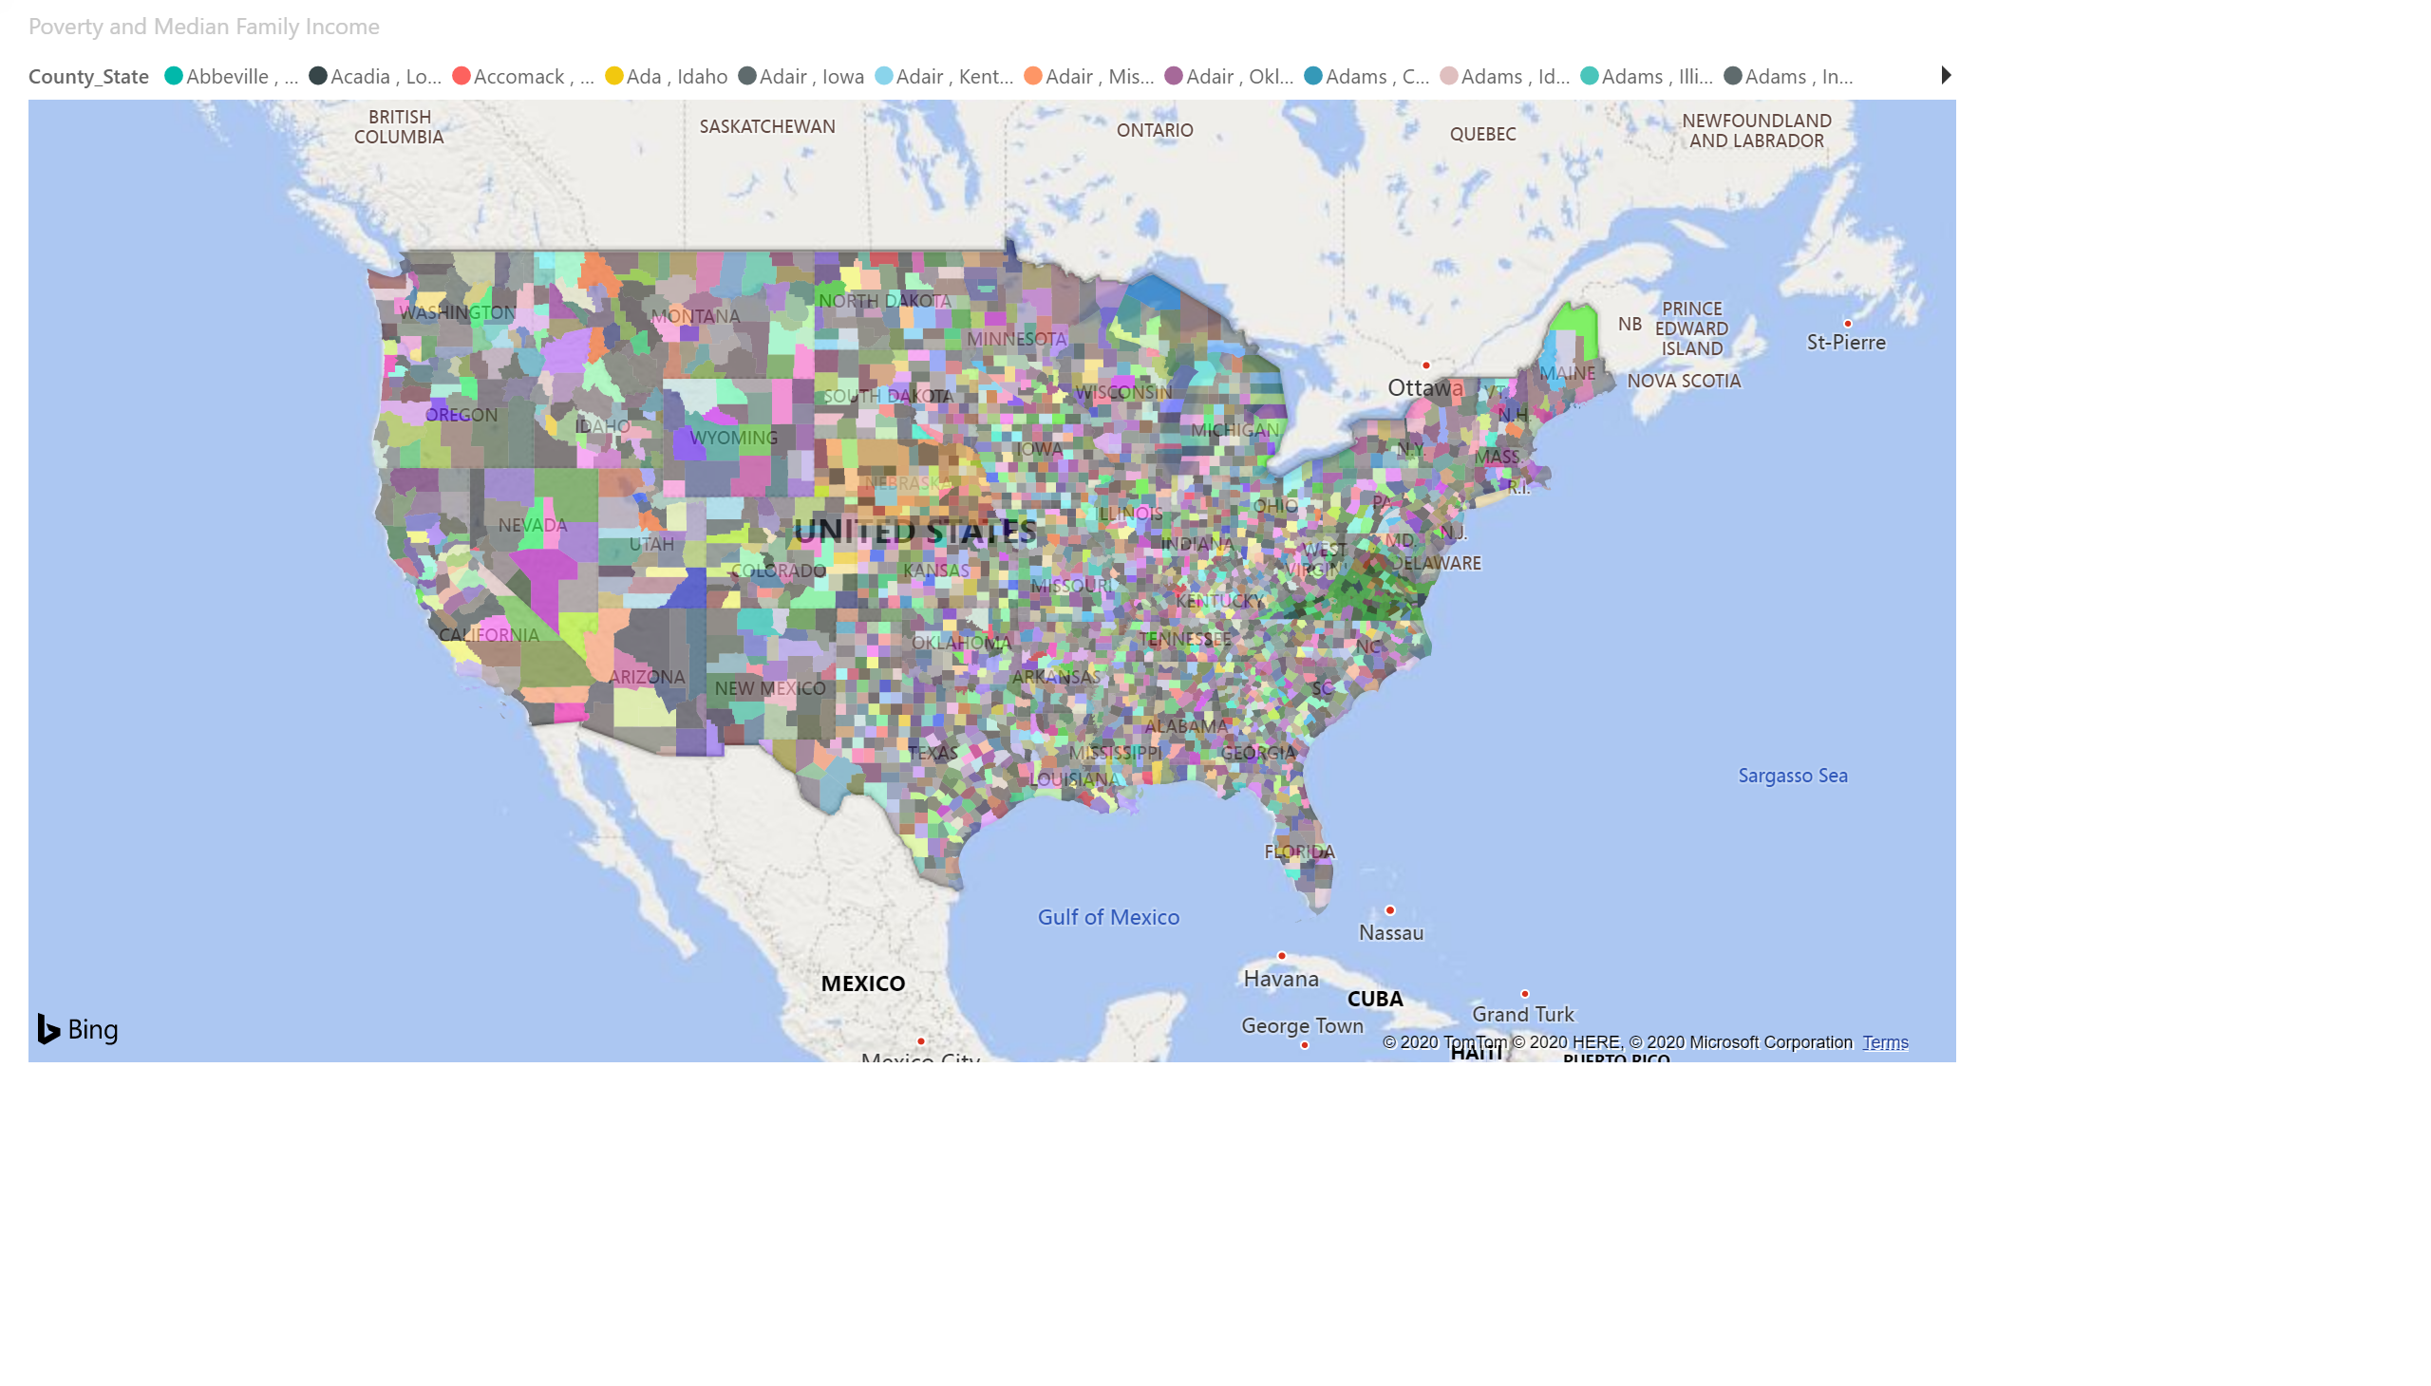

Slide 14
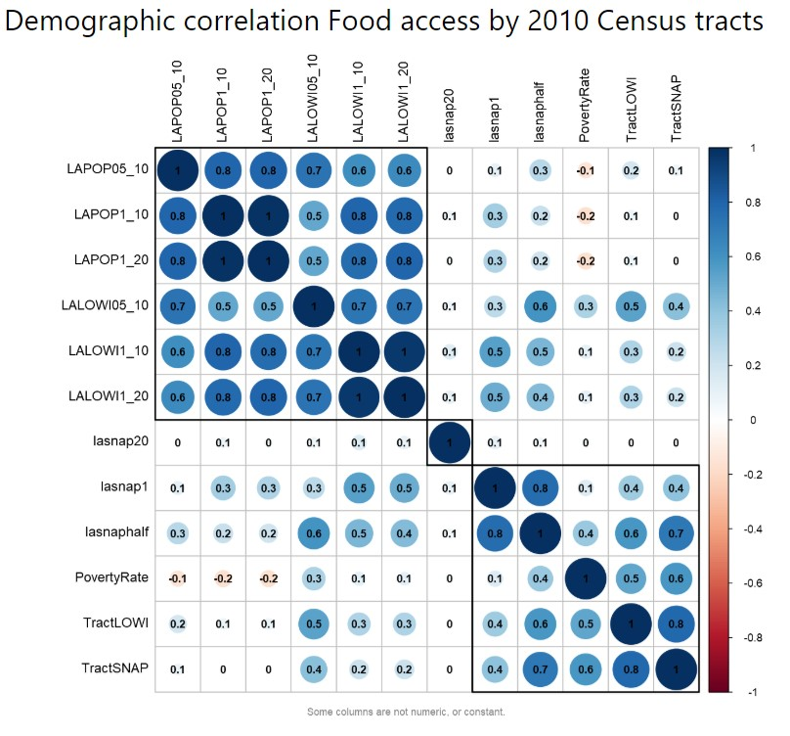
Levels of distance from a Supermarket
Low Access Census Tracts
General Population Count and
Low Income Population Count
Any distance from Food source
Poverty Rate
Low Income
SNAP Recipients
Housing units one mile
Housing units half mile
Field | LongName | Description
LAPOP1_10 | Low access, population at 1 mile for urban areas and 10 miles for rural areas, number | Population count beyond 1 mile for urban areas or 10 miles for rural areas from supermarket
LAPOP05_10 | Low access, population at 1/2 mile for urban areas and 10 miles for rural areas, number | Population count beyond 1/2 mile for urban areas or 10 miles for rural areas from supermarket
LAPOP1_20 | Low access, population at 1 mile for urban areas and 20 miles for rural areas, number | Population count beyond 1 mile for urban areas or 20 miles for rural areas from supermarket
LALOWI1_10 | Low access, low-income population at 1 mile for urban areas and 10 miles for rural areas, number | Low income population count beyond 1 mile for urban areas or 10 miles for rural areas from supermarket
LALOWI05_10 | Low access, low-income population at 1/2 mile for urban areas and 10 miles for rural areas, number | Low income population count beyond 1/2 mile for urban areas or 10 miles for rural areas from supermarket
LALOWI1_20 | Low access, low-income population at 1 mile for urban areas and 20 miles for rural areas, number | Low income population count beyond 1 mile for urban areas or 20 miles for rural areas from supermarket
lapophalf | Low access, population at 1/2 mile, number | Population count beyond 1/2 mile from supermarket
lasnap1 | Low access, housing units receiving SNAP benefits at 1 mile, number | Housing units receiving SNAP benefits count beyond 1 mile from supermarket

Slide 15
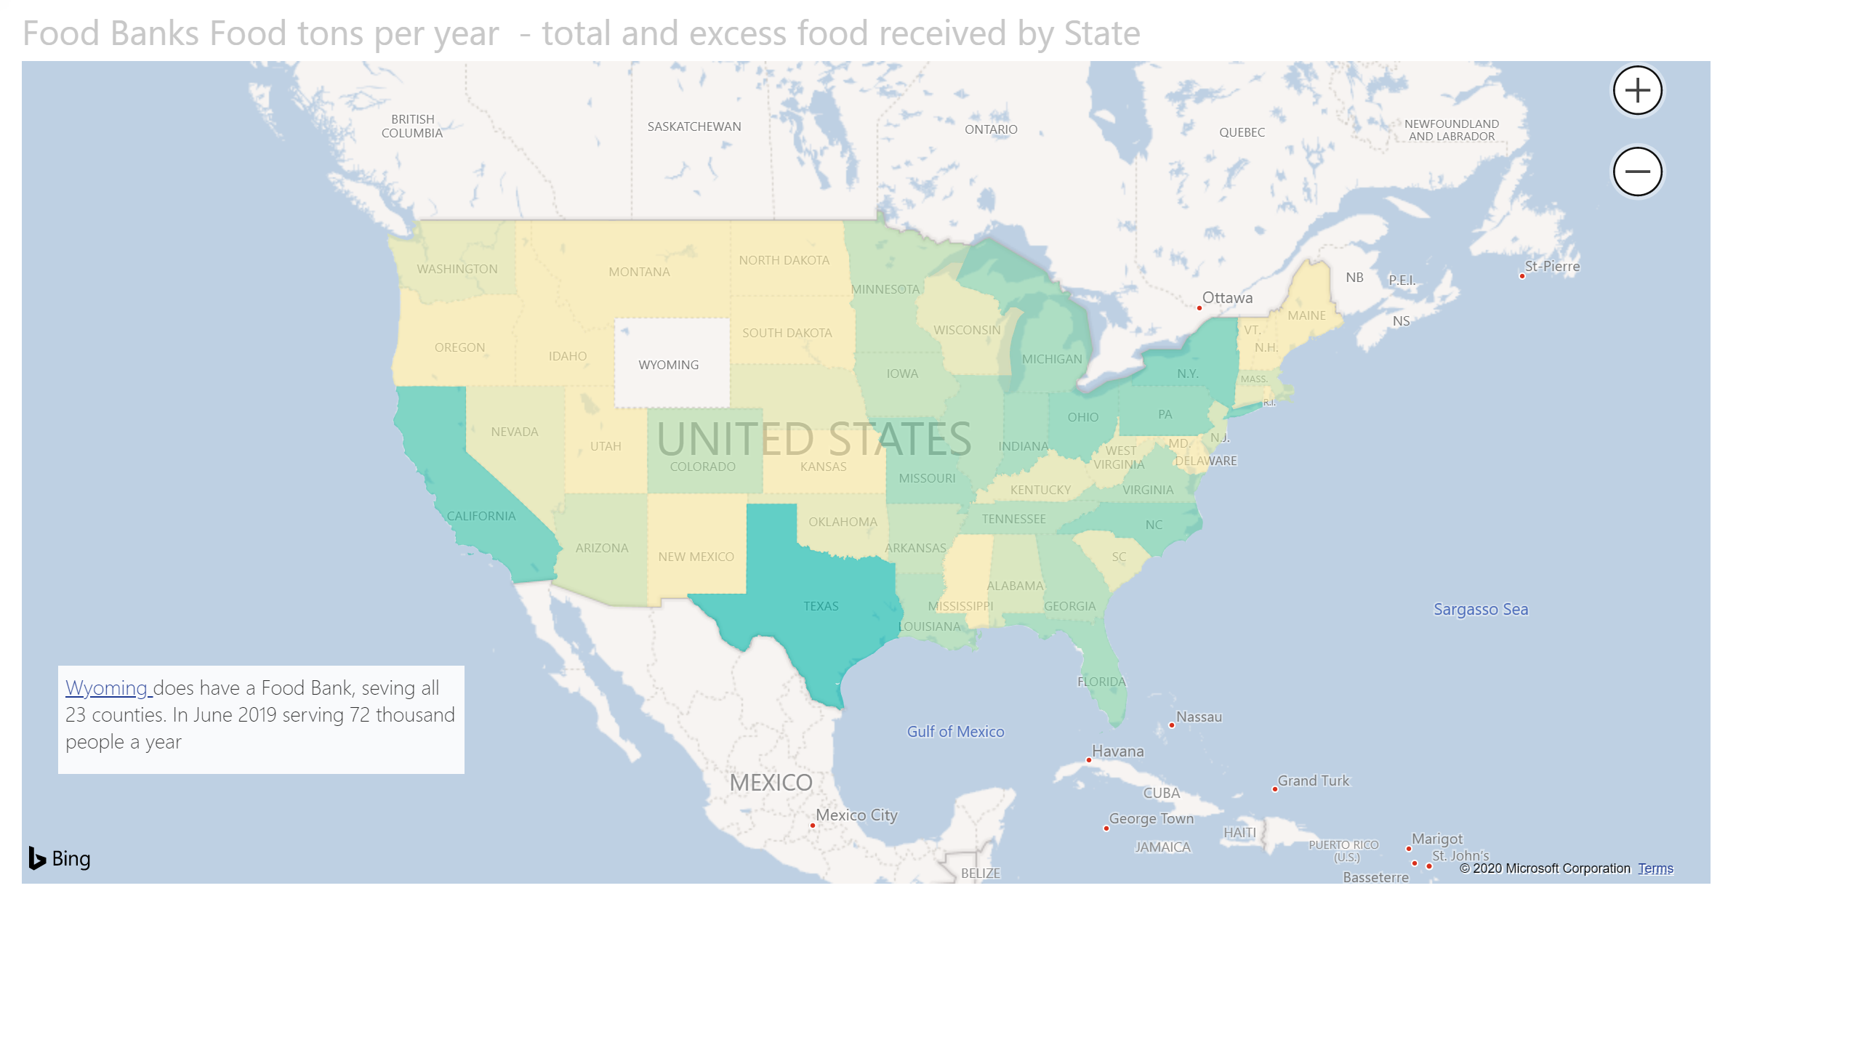

Slide 16
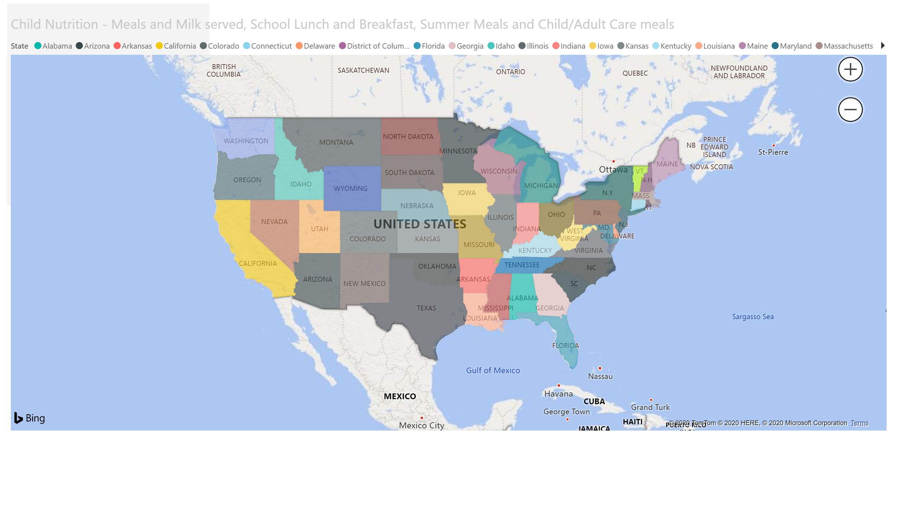

Slide 17
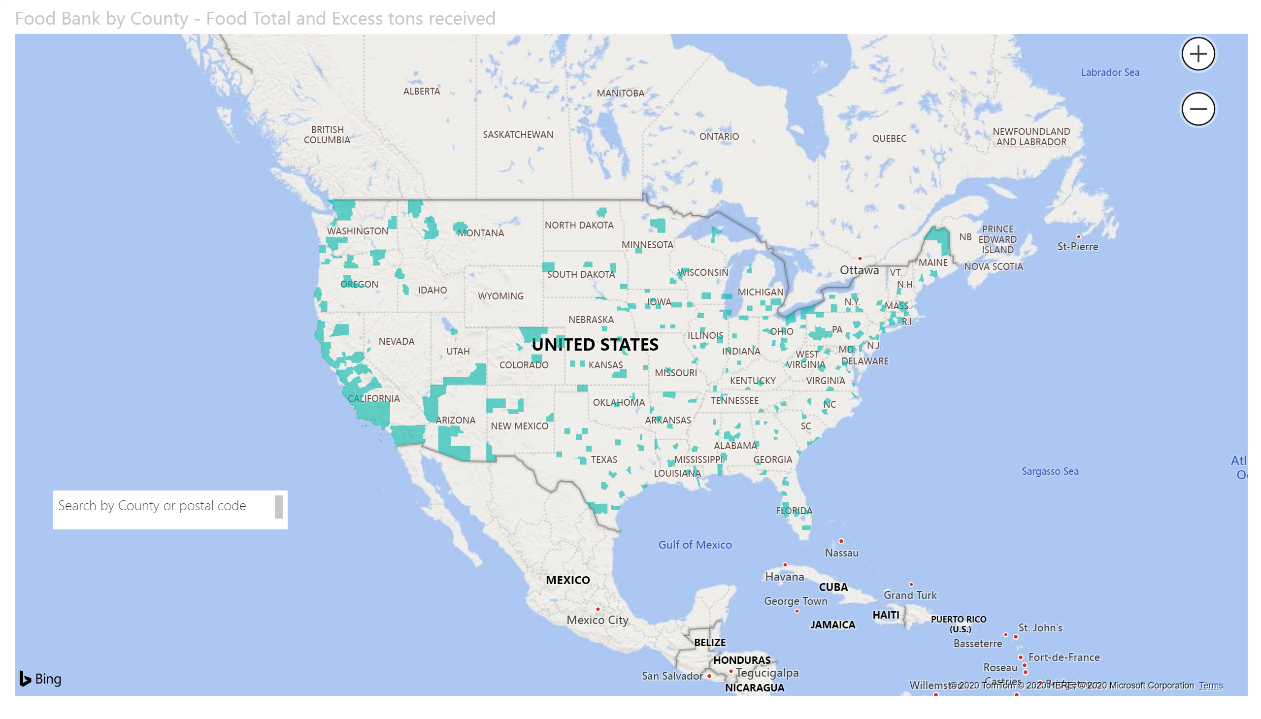

Slide 18
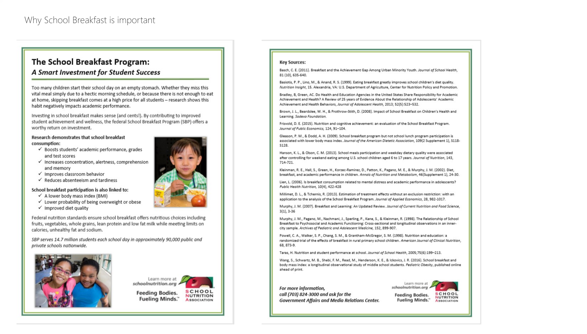

Slide 19
